Slide 1
Inside the Earth
Saturday Science

Slide 2
Crust
This is the thin, rocky layer we think of as Earth’s surface. Its thickness changes from about 50 miles to 3 miles.

Slide 3
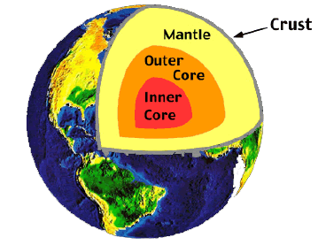
Crust

Slide 4
Mantle
This layer is rock hard, but it actually flows around the outer core, moving about as fast as your fingernails grow.
http://www.youtube.com/watch?v=uMcNCbR7B40
1:08-2:12

Slide 5
Mantle

Slide 6
Outer Core
This layer is also made up of mostly iron and nickel, but here the metals are melted into very hot liquid. This hot liquid forms a layer that moves around the inner core.

Slide 7
Outer Core

Slide 8
Inner Core
The center of the Earth is about 6,000 miles below the Earth’s surface. It is a solid ball made of mostly 2 materials: Iron and Nickel.
If we had a gallon jug of the earths core material, it would weigh more than 100 pounds!

Slide 9
Inner Core

Slide 10
Volcanoes and Earthquakes
Gyser/ Volcano
http://www.youtube.com/watch?v=uMcNCbR7B40
3:15- 3:50
Earthquake: when the surface of the earth that is floating on the mantle shifts from heat build up.

